Slide 1
Text classification With tensorflow in machine learning
By:
Name :B.kowsalya
Degree :B.E
Branch :CSE
College :PET Engineering College
NM ID :au963221104024
Email iD:kowsalya2004balu@gmail.com

Slide 2
outline
Problem Statement
Proposed solution
System Approach
Algorithm & deployment
Result
Conclusion
references

Slide 3
Problem statement
Problem Statement : Develop a program to assess sentiment in text input . Utilizing NLP techniques , the program aims to classify the sentiment of user - provided text as positive , negative , or neutral
Objective : The objective is to offer users insights into the emotional tone of their text data , facilitating sentiment analysis for purposes such as gauging public opinion or analyzing customer feedback .
Methodology : The methodology involves preprocessing the text data by tokenizing , removing stop words , and applying stemming or lemmatization . Subsequently , the program will employ a sentiment analysis model , trained on labeled datasets , to accurately classify the sentiment of the input text . Finally , the program will provide users with sentiment analysis results , along with relevant statistics or visualizations to aid in interpretation and decision- making
.

Slide 4
PROPOSED SOLUTION
Data Processing : Preprocessing text data to remove noise and irrelevant information . Tokenization and stop word removal to extract meaningful features . Vectorization of text data to convert it into a numerical format suitable for neural networks .
Neural Network Architecture : Utilizing word embeddings to represent text data . Designing a recurrent neural network ( RNN ) with Long Short - Term Memory ( LSTM ) cells for sequential data processing . Incorporating attention mechanism to focus on important parts of the input sequence and improve model performance
Training : Using categorical cross - entropy loss function for multi - class classification . Optimizing model parameters using Adam optimizer for efficient convergence . • Applying dropout regularization to prevent overfitting and improve generalization . Iteratively training the model on labeled text data to learn meaningful patterns and relationships

Slide 5
PROPOSED SOLUTION-CONT
Evaluation : Assessing model performance using metrics such as accuracy , precision , recall , and F1 - score . Conducting cross - validation to ensure robustness and generalization of the model . • Comparing the proposed model with baseline methods and state - of - the - art approaches to validate its effectiveness
Result Visualization : Visualizing model predictions and ground truth labels for qualitative analysis . Generating confusion matrices , ROC curves , and precision - recall curves to provide insights into model performance . Creating visualizations to interpret the attention mechanism and understand which parts of the input are crucial for predictions .
Saving Training Parameters : Saving trained model weights and architecture to deploy the model in production environments . Storing hyperparameters and training configurations for reproducibility and future reference . Exporting tokenizers and other preprocessing components to ensure consistency during inference .

Slide 6
System Requirement
Hardware Requirements : A computer with sufficient processing power ( CPU ) and memory ( RAM ) to handle training and evaluation of neural networks . The specific hardware requirements may vary depending on the size of the dataset and complexity of the neural network architecture .

Slide 7
SYSTEM APPROCH-CONT
software requirements:
1. Python 3.x : Required for coding the neural network model and data processing tasks .
2. TensorFlow : Deep learning library for building and training neural networks efficiently .
3. Keras : High - level neural networks API , running on top of TensorFlow , simplifying neural network implementation and experimentation .
4. NumPy : Fundamental package for numerical computing , essential for handling data arrays efficiently .
5. Pandas : Data manipulation and analysis library , useful for preprocessing and organizing the dataset .
6. Matplotlib : Data visualization library for creating static , interactive , and animated plots .
7. Scikit - learn : Machine learning library for various tasks like data preprocessing , model selection , and evaluation .

Slide 8
ALGORITHM AND DEPLOYMENT
Neural Network Architecture :
Input Layer : Receives input data , such as images or numerical features .
Hidden Layer : Processes the input data through a series of weighted connections and applies activation functions to generate hidden representations .
Output Layer : Produces the final output , such as class probabilities or regression values .
Training :The training process involves optimizing the neural network's parameters using techniques like backpropagation and gradient descent . It aims to minimize the difference between the predicted outputs and the actual targets by adjusting the weights and biases iteratively .

Slide 9
ALGORITHM AND DEPLOYMENT - CONT
Deployment :
Training Model : The trained model parameters ( weights and biases ) need to be saved in a format compatible with the deployment environment to ensure seamless loading during inference . File Storage : Store the trained parameters ( ' file1.txt ' and ' file2.txt ' in this case ) in a location accessible to the deployment environment for easy retrieval during deployment .

Slide 10
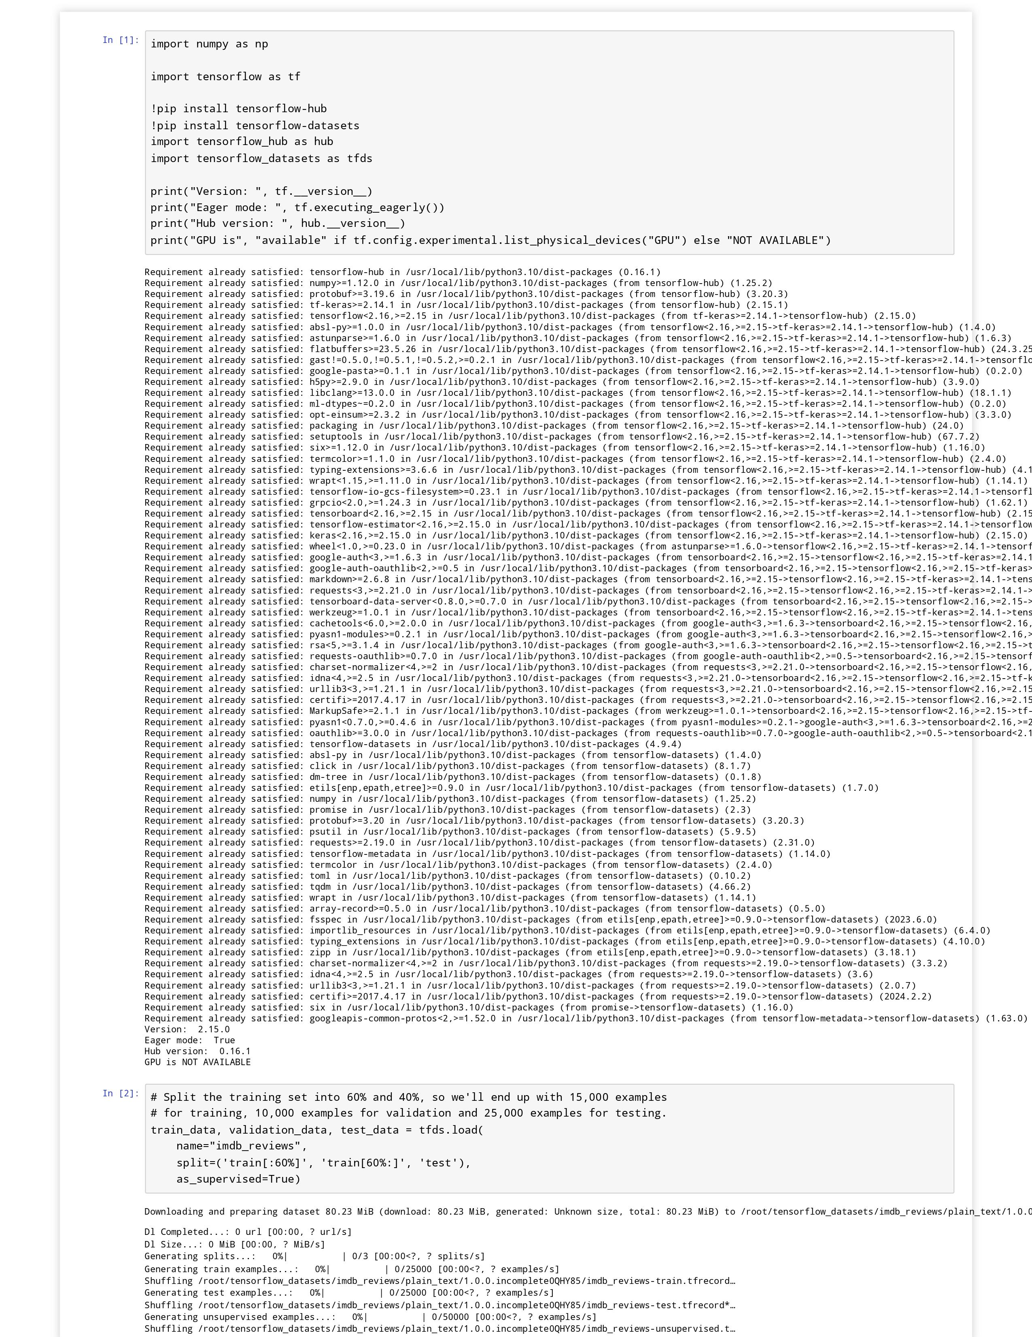
Result:

Slide 11
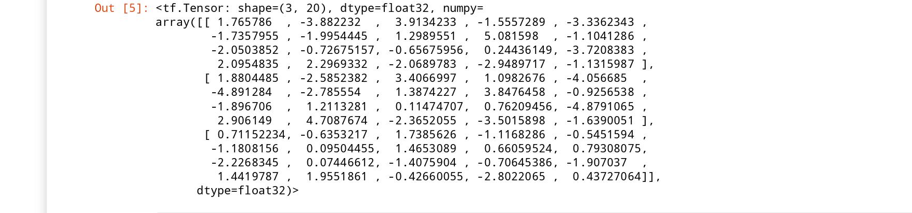
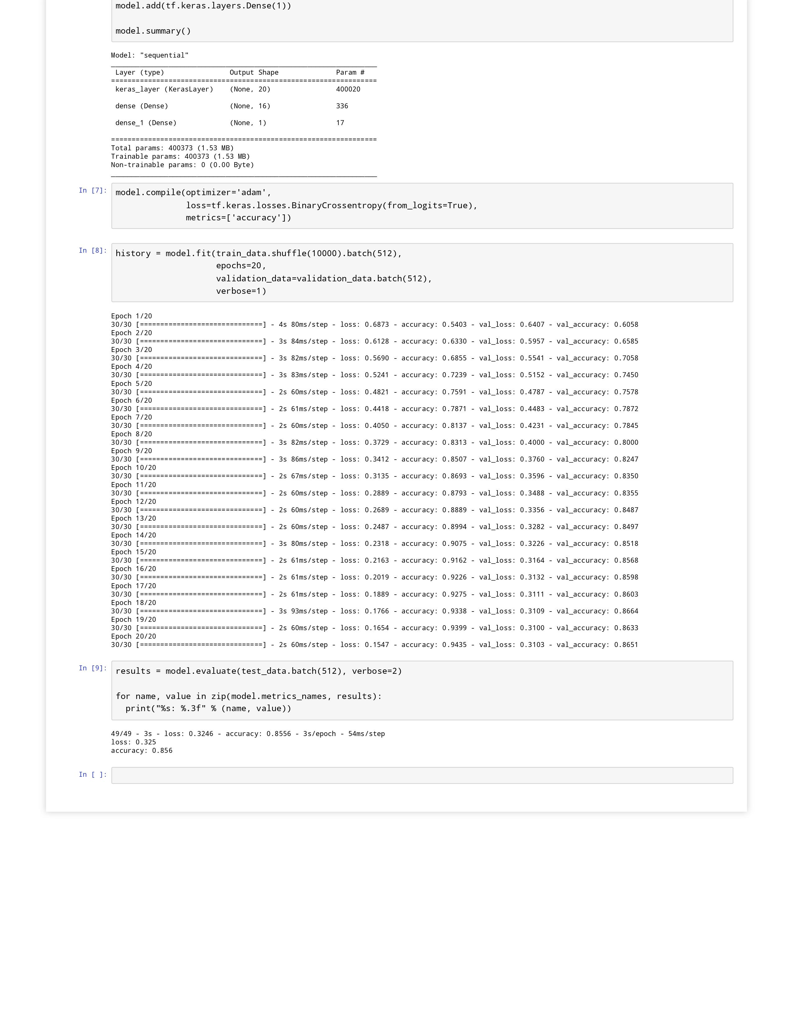

Slide 13
conclusion
In conclusion , this project successfully demonstrates the development and training of a neural network model using TensorFlow and Keras for sentiment analysis . Through careful data processing , the model was trained on a dataset of movie reviews . The proposed solution included the utilization of a pre - trained word embedding layer followed by additional dense layers , resulting in a total of 400,373 trainable parameters . The trained model was deployed and integrated into a graphical user interface using Tkinter , ensuring accessibility and ease of use . Overall , this project hights the effectiveness of neural networks in natural language processing tasks and underscores the importance of robust data processing techniques for model training .

Slide 14
reference
https://www.tensorflow.org/guide
https://keras.io/guides/
https://docs.python.org/3/
http://neuralnetworksanddeeplearning.com/

